Slide 1
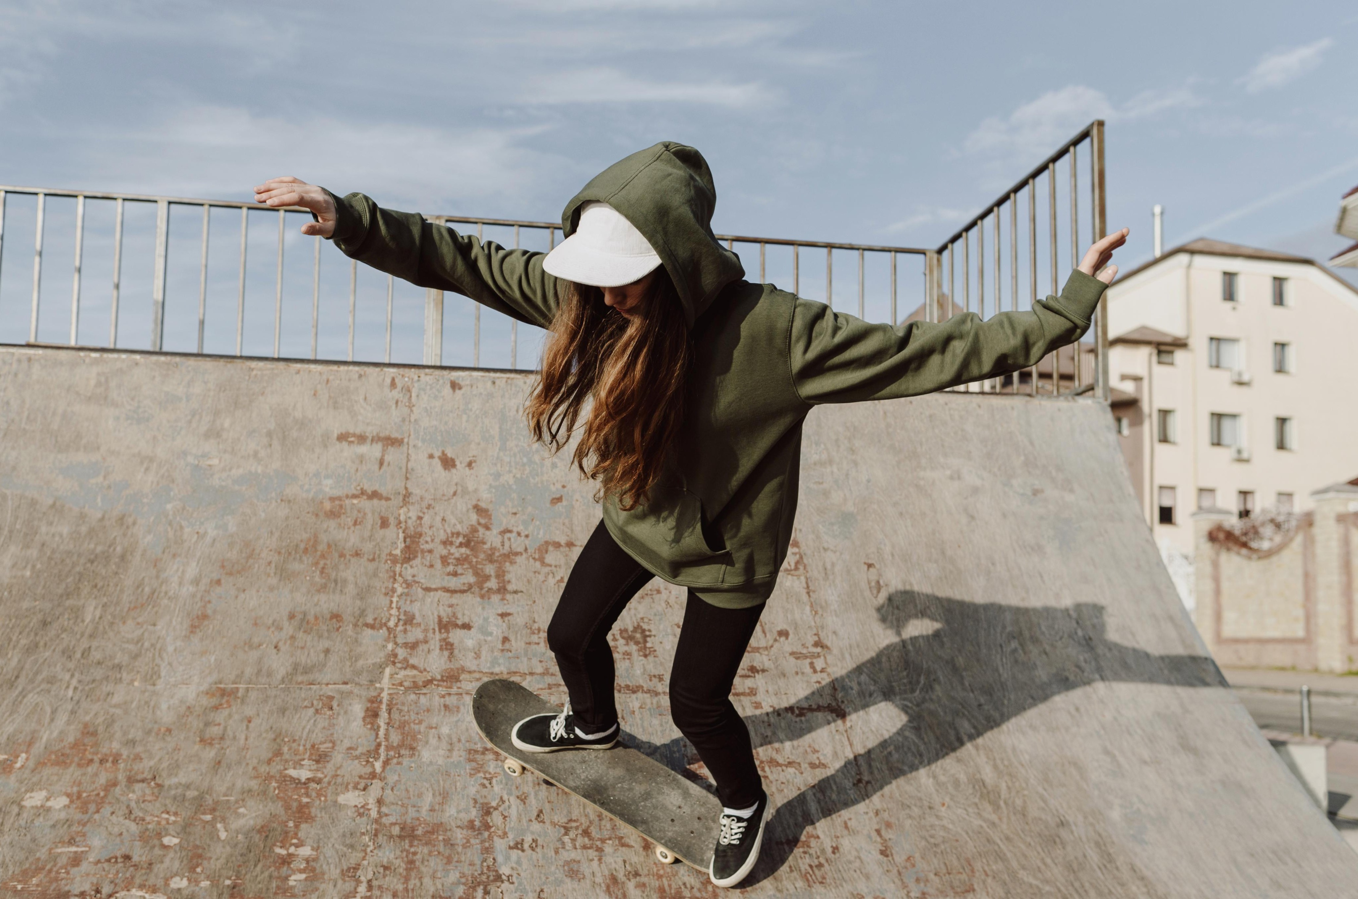




Slide 2
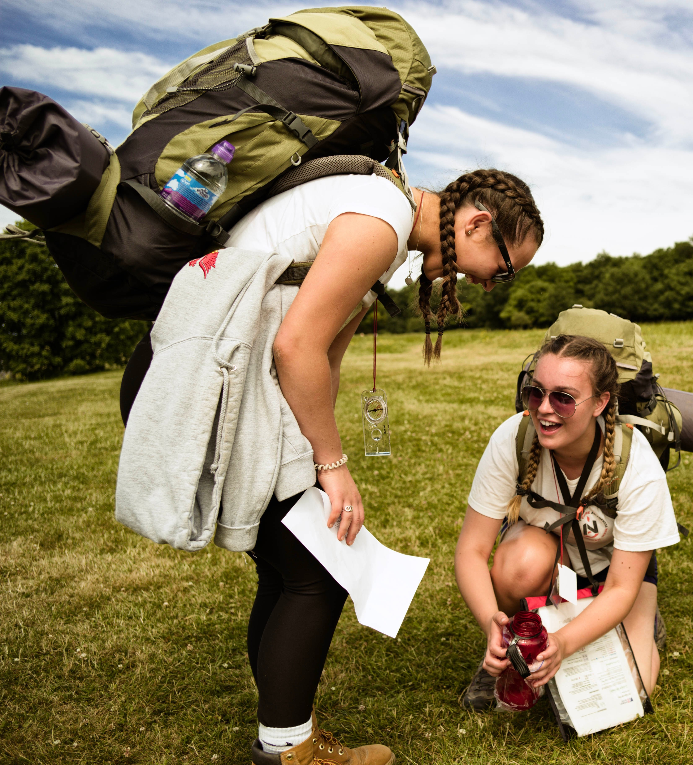

What is the DofE?
The DofE is a life-changing adventure.
You make it: The DofE is as unique as you are
Millions of young people in the UK have already done their DofE.
Now it’s your turn.
Notes:
The DofE is a life-changing adventure which will help you develop the skills you need for your future life and work. ​
The DofE gives you the chance to discover just how much you’re capable of.
It’s a great way to meet new people, try new things, do what you love and make a difference in your community.

Slide 3
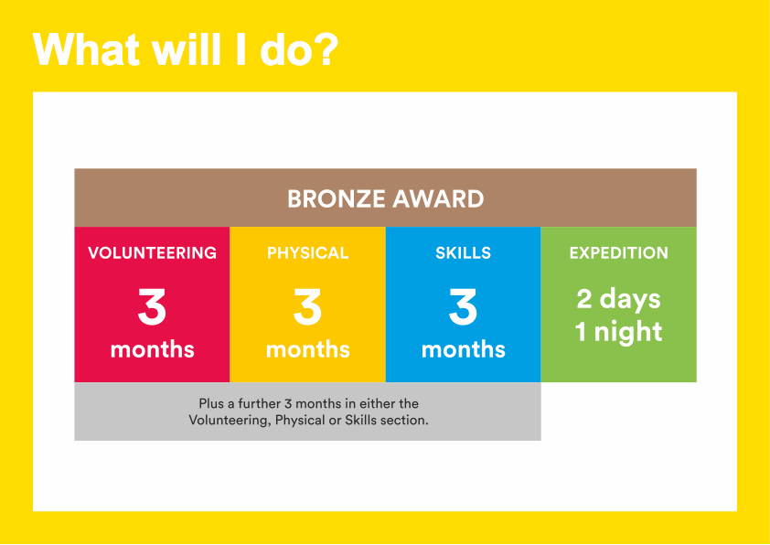
Notes:
To achieve your DofE Bronze Award, you will need to complete four sections – Volunteering, Physical activity, developing a skill and the Expedition.​
Activities for each section take a minimum of one hour a week, so they can easily fit in around your studies and other interests.​
You will need to spend at least 3 months completing each of the Volunteering, Physical and Skills sections.
You will also need to decide which one of these you would like to do for six months.​
You will need to keep a record of the time you spend on each activity.
You should ask somebody who has a good understanding of the activity you have chosen to write a report describing what you have done.​
It may seem daunting at first but remember that most activities can count towards your DofE.
I will now describe each section of the award in more detail.

Slide 4

Volunteering section
Take action and make a difference to the causes you care about
Help others and change things for the better
Notes:
As part of your Bronze DofE Award, you will need to donate some of your time to volunteering.​
Volunteering is a chance to help other people, and to make a difference to the causes you feel most passionate about.​
As well as changing things for the better, lots of young people find that volunteering is a great way to increase their confidence and gain new skills.​
Examples of volunteering could be coaching a local football team, collecting items for a foodbank or campaigning for change on issues you feel passionate about
Presenter: Feel free to include a broad range of examples here and to talk about what previous participants have done.
You can choose to volunteer in any area you would like – the only rule is that you must not be doing a job that companies would normally pay somebody for.​

Slide 5
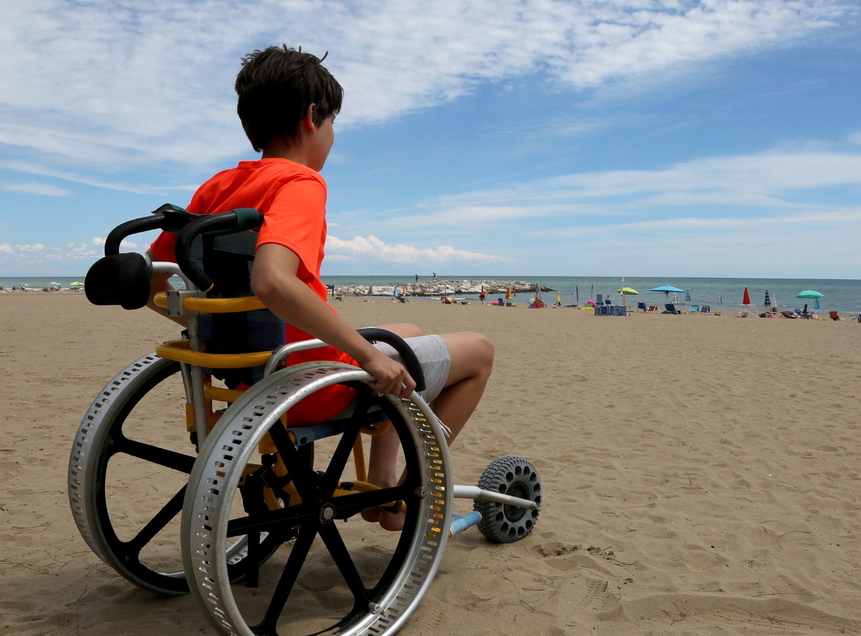

Physical section
Take part in whatever
dance, sport or ﬁtness
activity you would like
Get ﬁtter and have fun
along the way!
Notes:
To complete the Physical section of your Bronze Award, you will have the opportunity to take part in regular physical activity.
Becoming more active can be a huge amount of fun, and it can also help you feel happier and healthier.
Almost any dance, sport or fitness activity can count — it’s completely up to you which activities you choose.
You may decide to join a team or to do something on your own.
You may like to try something completely different, or to concentrate and improve on an activity you already do.
​

Slide 6
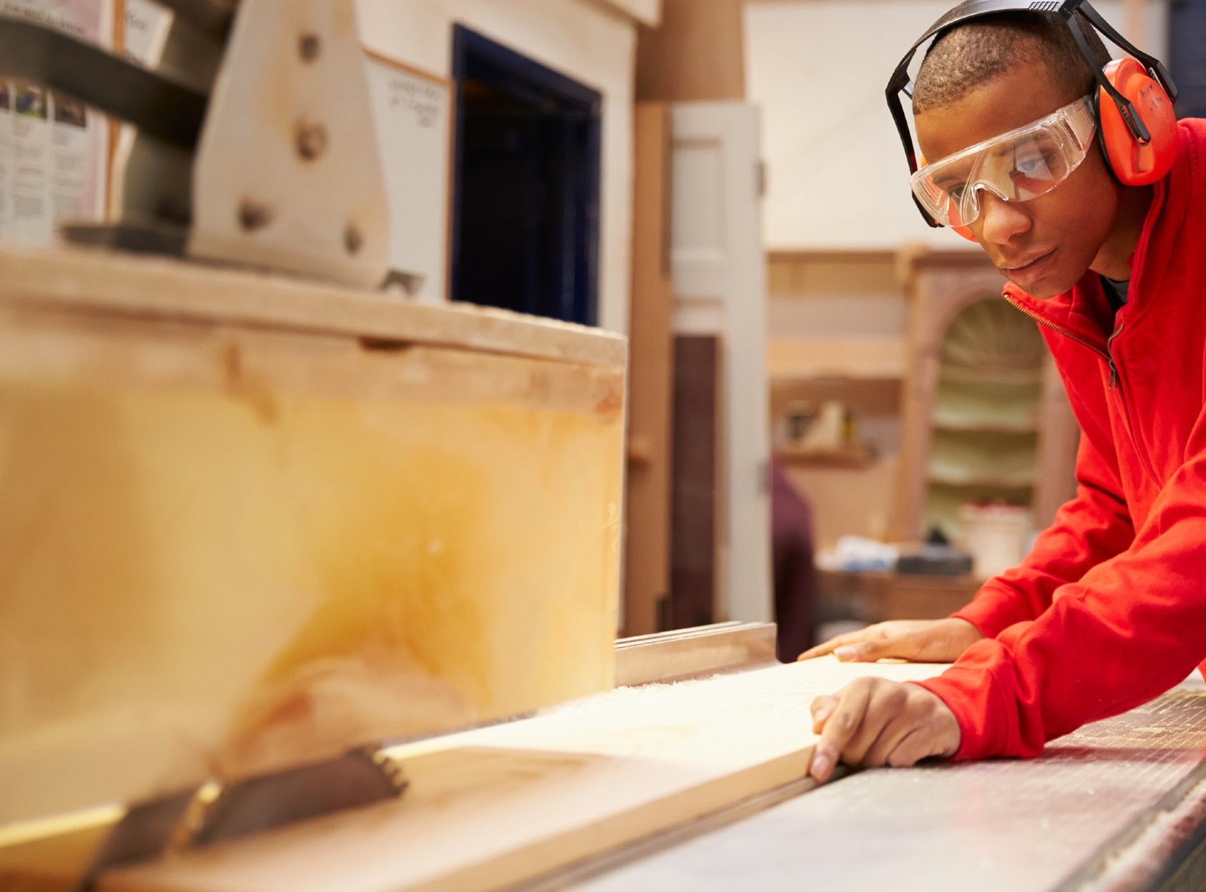
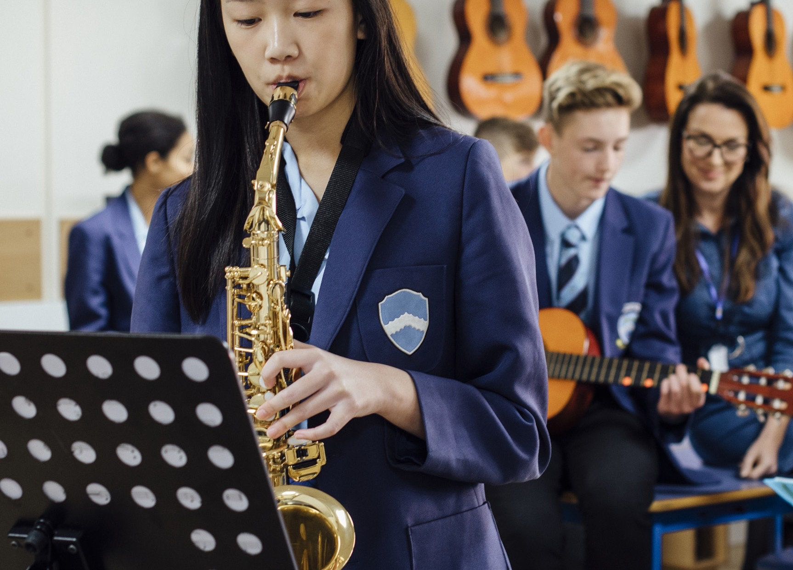
Skills section
Devote yourself to improving your skills in the things you love to do
Discover new passions and develop talents you didn’t know you had
Notes:
Through the Skills section, you will be encouraged to develop your practical and social skills in an area you can choose.
You can decide whether you will try to get better at something you already feel passionate about, or learn to do something new.
In the past, young people have done a huge range of different activities for their skills section, such as computer coding, driving and cooking.
Presenter: Please add in your own examples here.
Gaining new interests and talents is a huge amount of fun and lots of young people also feel a real sense of achievement from doing it.
​

Slide 7
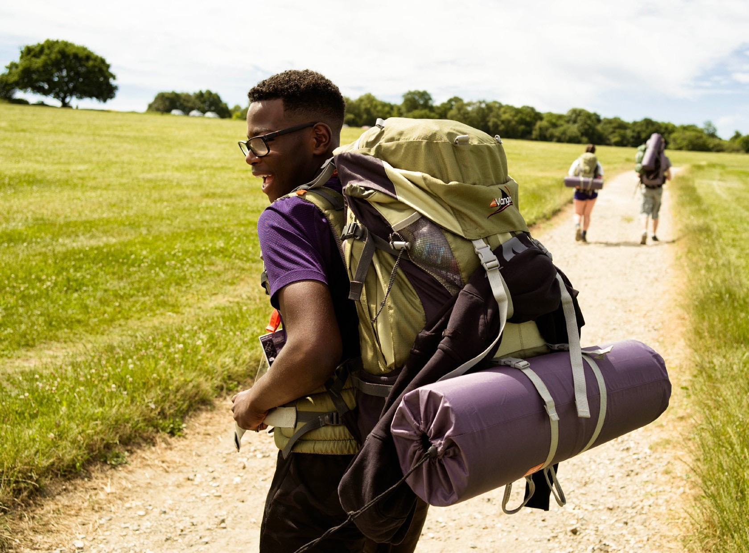

Expedition
Explore the great outdoors and spend a night away from home
Create memories that will last a lifetime
Notes:
The final section of your Bronze DofE Award is the Expedition.​
​As part of a small team, you’ll plan your aim, choose your location and do some training to make sure you’re prepared and know what you’re doing — then spend two days and one night away.​
​You can choose how you want to travel – it doesn’t have to be on foot. You could do it by bike, canoe, kayak, wheelchair, sailing boat or even on a horse.​
​Your Expedition will improve your resilience, communication, teamwork and leadership skills. ​
​Presenter: Please take care to place the same level of emphasis on each of the four sections. Whilst some young people may be attracted to the DofE because of the expedition, we know that some young people find this element daunting, so may need careful reassurance.
​

Slide 8
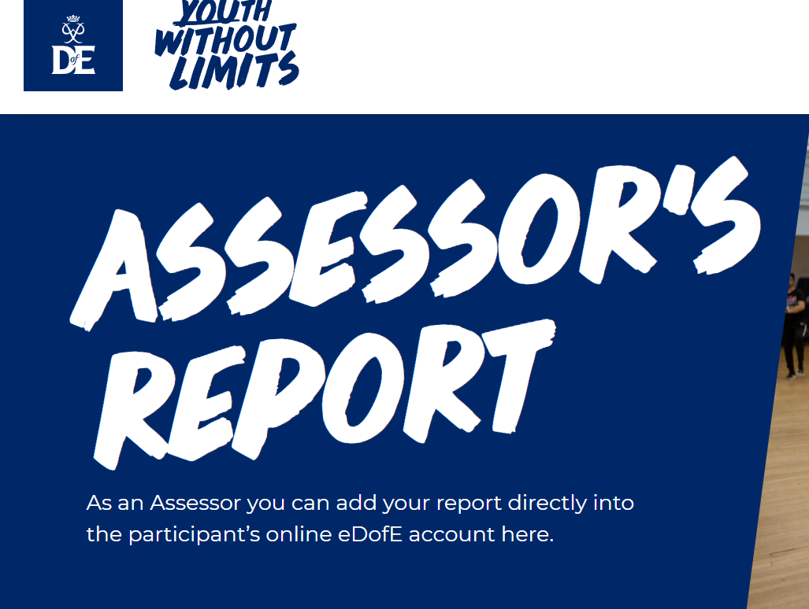
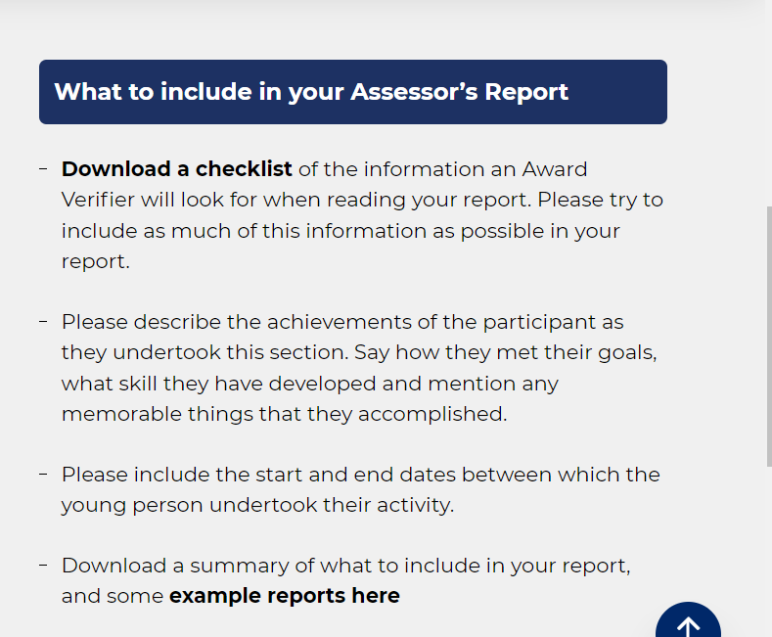
Assessors
Every participant needs to identify an adult who can be their assessor for each of the sections
Reports can be completed online or through the welcome pack
Notes:
The final section of your Bronze DofE Award is the Expedition.​
​As part of a small team, you’ll plan your aim, choose your location and do some training to make sure you’re prepared and know what you’re doing — then spend two days and one night away.​
​You can choose how you want to travel – it doesn’t have to be on foot. You could do it by bike, canoe, kayak, wheelchair, sailing boat or even on a horse.​
​Your Expedition will improve your resilience, communication, teamwork and leadership skills. ​
​Presenter: Please take care to place the same level of emphasis on each of the four sections. Whilst some young people may be attracted to the DofE because of the expedition, we know that some young people find this element daunting, so may need careful reassurance.
​

Slide 9


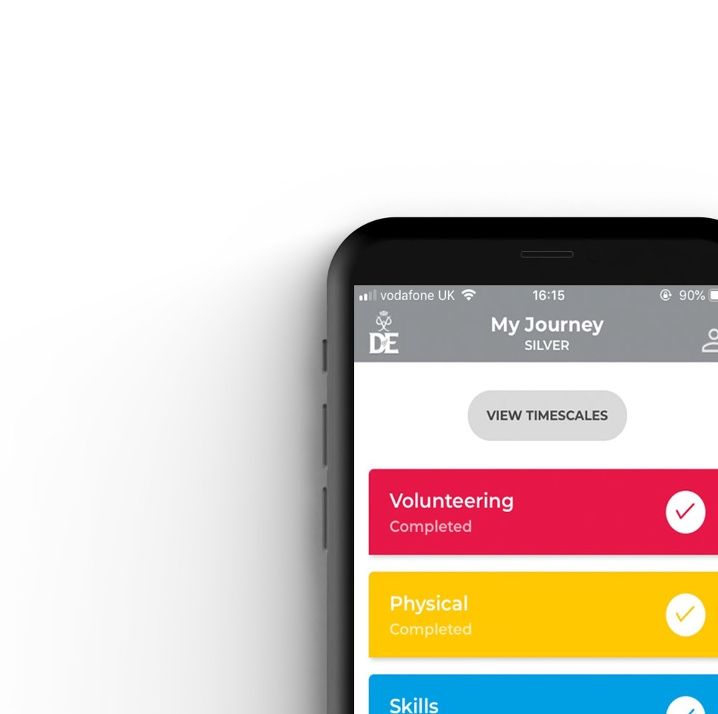


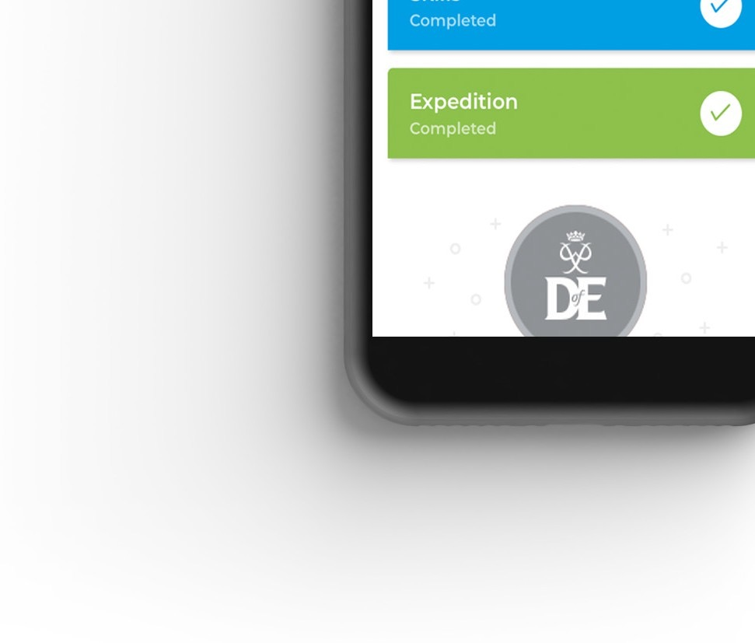
Your Welcome Pack and eDofE
Notes:
Once you have signed up to do your DofE, you will receive a Welcome Pack in the post which contains lots of useful information and advice. ​
​You will also get your own eDofE account so that you can plan your activities online using the free DofE app.​
​You will also receive a DofE Card which will give you and your family money off in several shops selling the sorts of equipment you may need.​

Slide 10
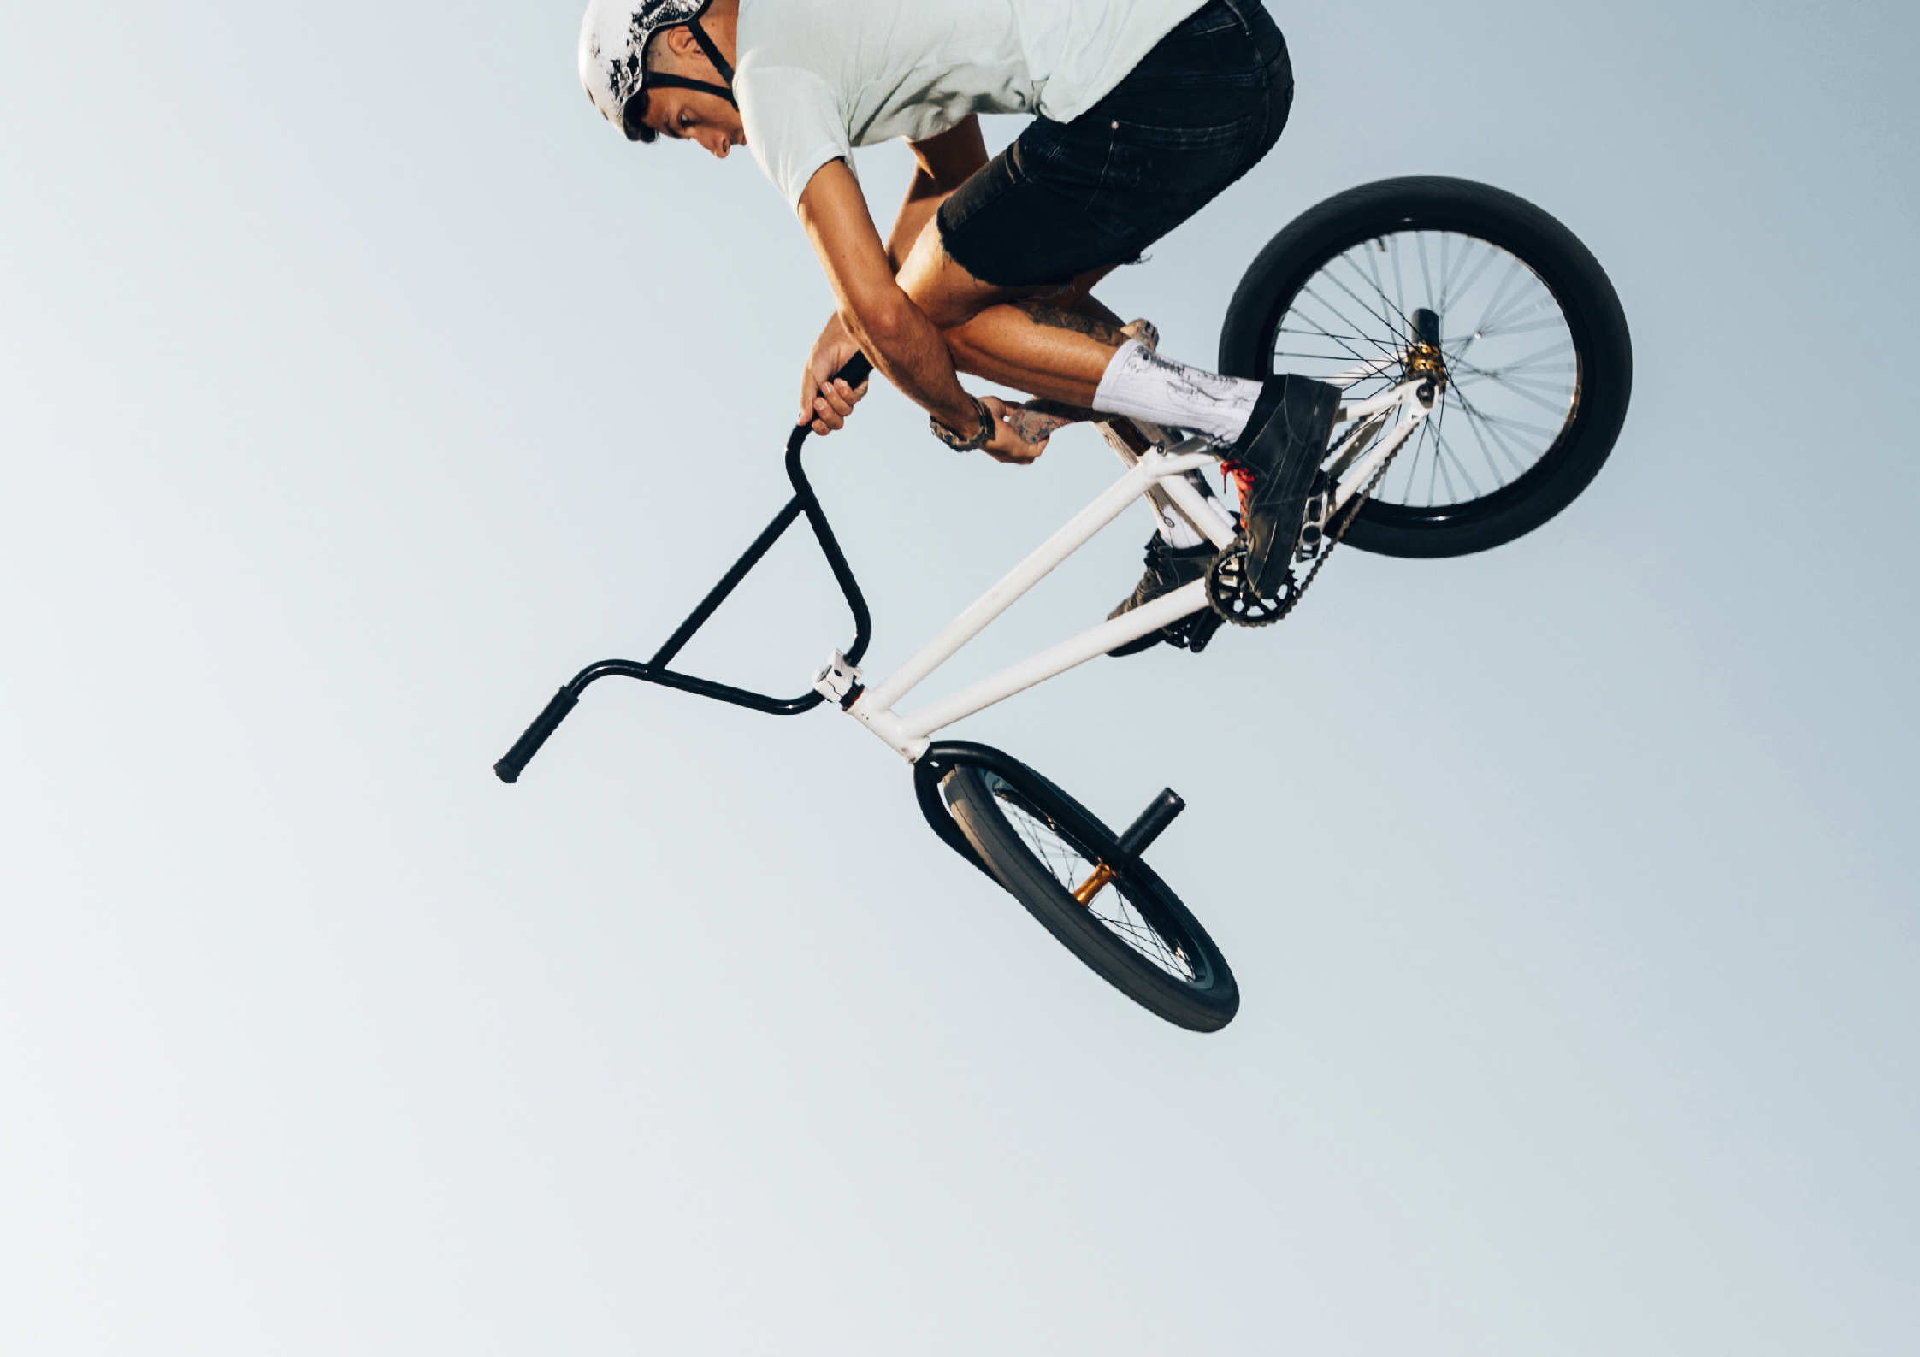




Slide 11
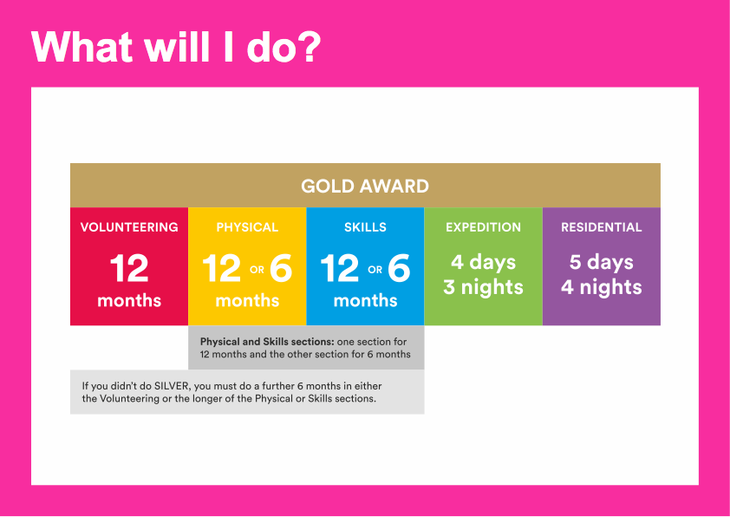
Notes:
To achieve your Gold DofE Award, you will need to complete five sections – volunteering, physical activity, developing a skill, the expedition and a residential.​
​You will need to spend at least 12 months completing your volunteering section, and at least 6 months on your physical and skills sections. You will also need to decide which two of these you would like to do for 12 months.​
If you have not already completed your Silver DofE Award, you will need to do a further 6 months in any 1 of the Volunteering, Physical or Skills sections.​
​You will need to keep a record of the time you spend on each activity and to ask somebody who has a good understanding of the activity you have chosen to write a report which describing what you have done.​
​For each section you can choose what you want to do – you can try something new or choose to get better at something you already do. Your DofE can be whatever you want it to be.​
​I will now describe each section of the Gold Award in more detail.​
​

Slide 12

Volunteering section
Take action and make a difference to the causes you care about
Help others and change things for the better
Notes:
As part of your Gold DofE Award, you will need to donate your time to volunteering.​
​Volunteering is a chance to help other people, or to make a difference to the causes you feel most passionate about.​
​If you have already completed your Bronze or Silver Award you will be familiar with this part of the Award and will know that Volunteering is a great opportunity to change things for the better whilst adding to your own skills and confidence.​
​Examples of volunteering could be coaching a local football team, collecting items for a foodbank or campaigning for change on issues you feel passionate about
Presenter: Feel free to use examples of previous participants and include a broad range of examples.​
​You can choose to volunteer in any area you would like – the only rule is that you must not be doing a job that companies would normally pay somebody for.​
​

Slide 13
Physical section
Take part in whatever dance, sport or fitness activity you would like
Get fitter and have fun along the way!
Notes:
To complete the Physical section of your Gold Award, you will have the opportunity to take part in regular physical activity. ​
​Becoming more active can be a huge amount of fun, and it can also help you feel happier and healthier.​
​Almost any dance, sport or fitness activity can count – it’s completely up to you which activities you choose.​
​You may decide to join a team or choose something you can do on your own.​
​You may like to try something completely different, or to concentrate and improve on an activity you already do.​
​

Slide 14
Skills section
Devote yourself to improving your skills in the things you love to do
Discover new passions and develop talents you didn’t know you had
Notes:
Through the Skills section, you will be encouraged to develop your practical and social skills in an area you can choose.​
​You can decide whether you will try to get better at something you already feel passionate about, or try to learn to do something new.​
​Again, lots of activities can count for this section, from music and drama, through to cooking, gardening or learning to drive.
Presenter: Please add in your own examples here.

Slide 15
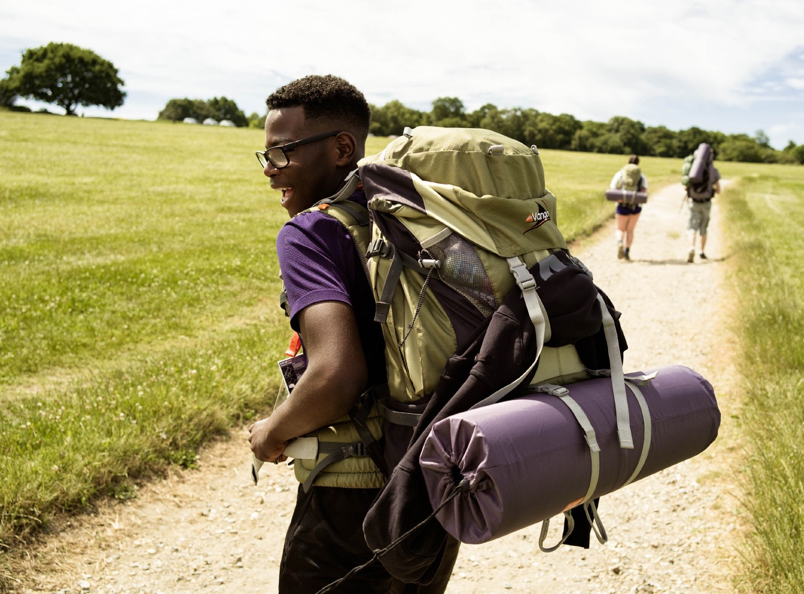
Expedition
Explore the great outdoors and spend three nights away from home
Create memories that will last a lifetime
Notes:
As part of your Gold DofE Award you will complete an expedition.​
​As part of a small team, you’ll plan your aim, choose your location and do some training to make sure you’re prepared and know what you’re doing — then spend four days and three nights away.​
You can choose how you want to travel – it doesn’t have to be on foot. You could do it by bike, canoe, kayak, wheelchair, sailing boat or even on a horse.​
​Your expedition will improve your resilience, communication, teamwork and leadership skills. ​
​Presenter: Please take care to place the same level of emphasis on each of the four sections. Whilst some young people may be attracted to the DofE because of the expedition, we know that some young people find this element daunting, so may need careful reassurance.
​
​

Slide 16
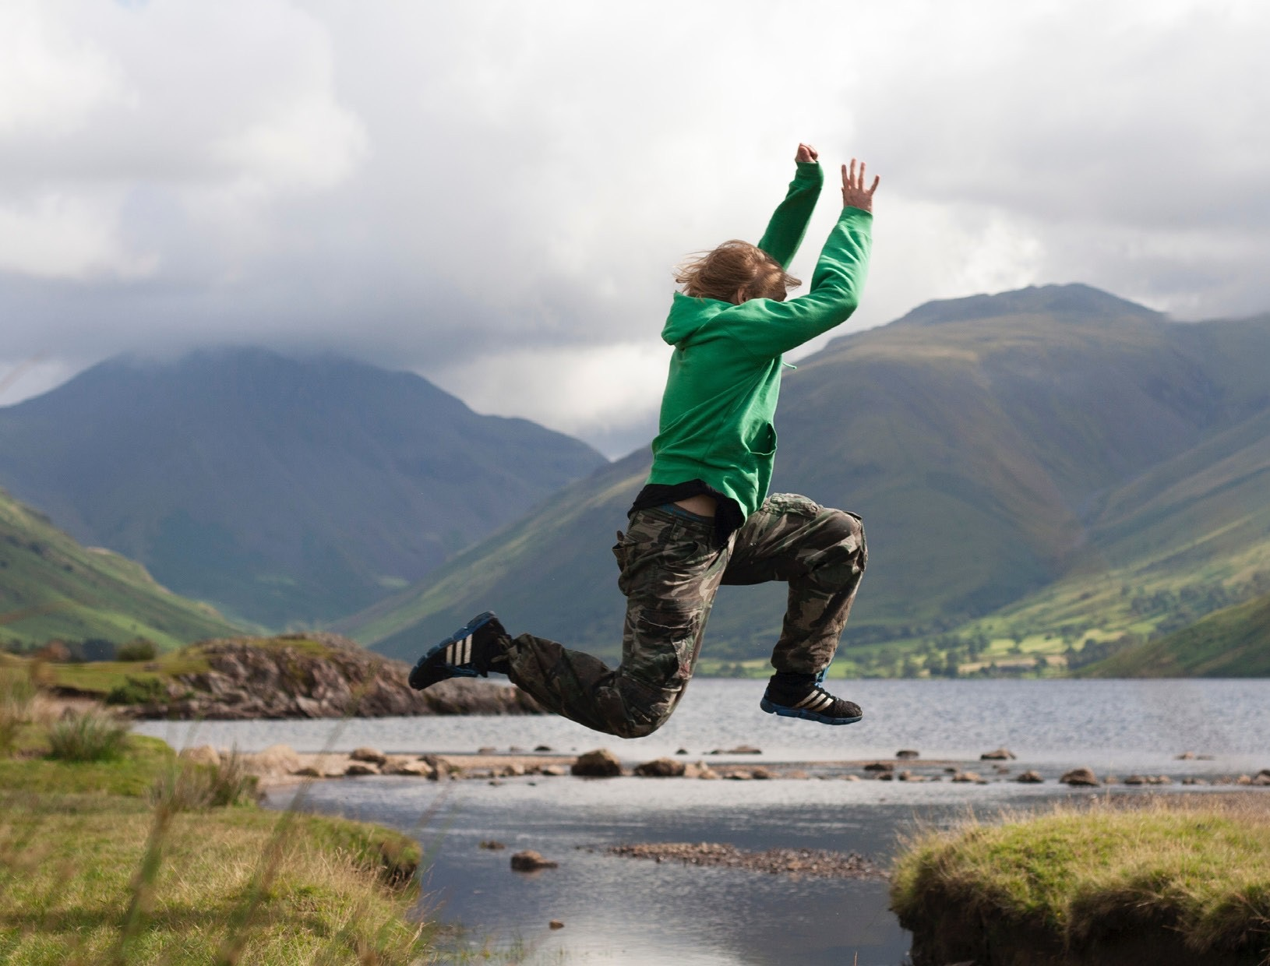
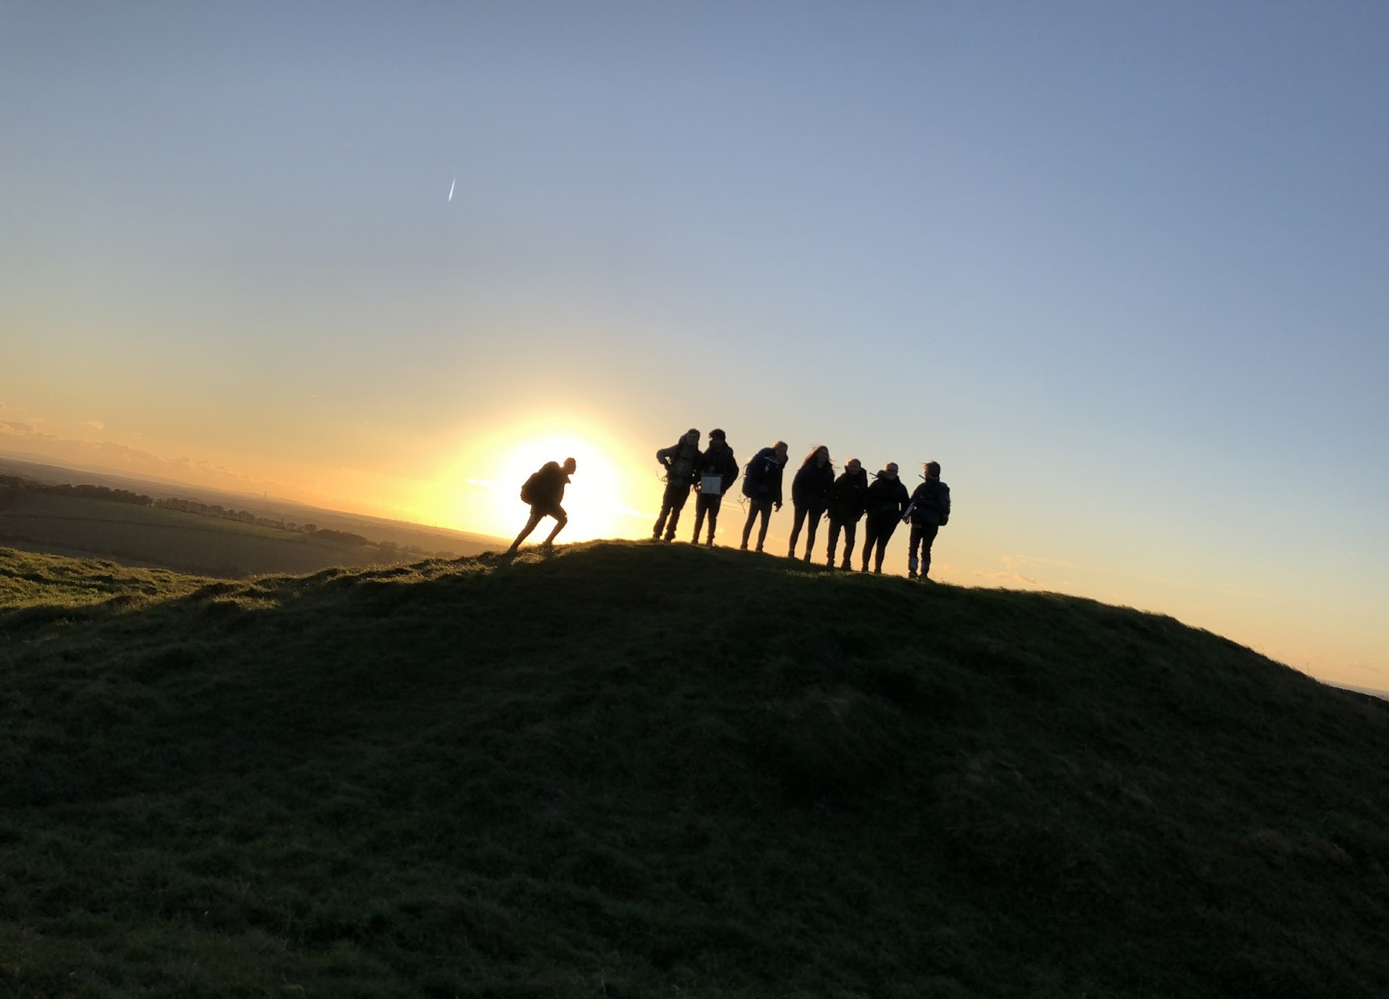
Residential
Spend five days and four nights away from home
Share experiences and create new connections
Notes:
To achieve your Gold Award, you need to complete an extra section – the Residential. ​
​It’s a big, exciting and fulfilling experience, spending five days and four nights away from home on a shared activity with people you’ve never met before. ​
​From learning to snowboard in Scotland to helping at a children’s camp, there are lots of exciting possibilities to get involved with — both in the UK and abroad. ​
​You’ll learn how to work with people from different backgrounds and build confidence staying in new environments. ​
​You may want to build on a talent you’ve developed in another section, learn something completely new on an intensive course or do something to help others.​
​

